Slide 1
Objectives
Iron Metabolism
Explain the functions and distribution of Iron in human body
List the different sources of iron
Discuss the absorption, transport and excretion of iron
Discuss the principle of estimation of body iron states and diagnostic importance of serum iron estimation
Explain the changes in Body’s Iron status under various conditions ; Iron deficiency and overload

Slide 2
Iron [Fe]
Iron (Fe) is one of the essential trace elements
May be present as:
  Fe³⁺ + e⁻ Fe²⁺
  Ferric (oxidized) Ferrous (reduced)
Redox states allows activities passing electrons around body
Redox change required for iron metabolism

Slide 3
Significance of iron in human body
Transport and storage of oxygen [hemoglobin & myoglobin]
Cellular respiration [cytochromes]
Enzyme active site constituent [Succinate dehydrogenase, aconitase, Catalase]
Formation and maturation of red blood cells
Mayelogenesis and maintenance of myelin in nerve cells

Slide 4
Distribution of Iron
Total Iron content in healthy adult : 4.0 – 5.0 g
Haeme iron compounds | Non - haeme iron compounds
Haemoglobin (65-80% of body iron) - Myoglobin (10%) Cytochrome C (<1%) Peroxidase (<1%) | Ferritin (10 -15%) Haemosiderin (9%) Transferrin (<1%) Catalase (<1%)
Other iron compounds (<5%) is mainly present bound to proteins.

Slide 5
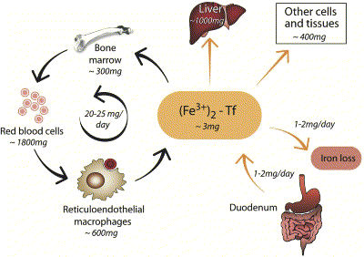

Slide 6
Distribution of Iron
Based on location
  Hemoglobin iron in erythrocytes
  Tissues iron: Myoglobin, Cytochromes, enzymes (catalase and peroxidase) ferritin and small amount of hemosidrin
  Plasma iron: transport iron (transferrin)

Slide 7
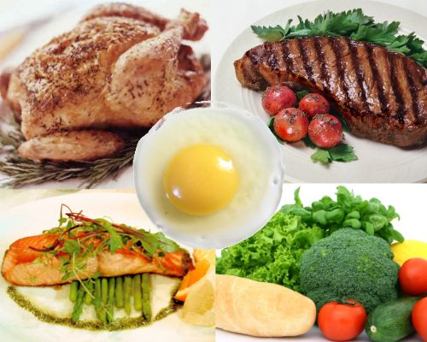
Dietary Sources
Fe²⁺ (heme iron)
  Organ meat (Liver, heart , kidney, Spleen)
Fe³⁺ (non heme iron)
  Green vegetables, Dates, Nuts
  Egg yolk –rich in iron but not bio-available

Slide 8
Recommended dietary allowances per day
Daily requirement: 1-2 mg/day
Infants: 10-15 mg
Children:
… 1-3 yrs: 15 mg
… 4-10 yrs: 10 mg
Older children and adults (Males):
… 11-18 yrs: 18 mg
… After 19 yrs: 10 mg
Females:
… 11-50 yrs: 15-18 mg
During pregnancy or lactation: 20 mg
After 51 yrs: 12-15 mg

Slide 9
Iron regulation
Iron homeostasis is regulated strictly at level of
      1 Intestinal absorption.
      2 Transport
      3 Storage
      4 Exctretion
Clinical relevance: Iron deficiency affects the whole body, Excess free iron can lead to serious organ damage

Slide 10
Iron absorption
Daily dietary intake ∼ 20 mg/day
About 10 % of daily intake is absorbed
Iron absorption occurs primarily in the duodenum
Most of the iron in the diet is in the ferric (Fe³⁺) form
Ligand Fe³⁺ Fe³⁺ + Ligand
Ascorbic acid, Cystine
Fe³⁺ Fe²⁺
Acidic pH (stomach)
Alkaline pH , Ferri reductase
Notes:
. Fe³⁺ reductase activity is associated with the iron transporter in the brush borders of the enterocytes Gastric secretions dissolve the iron and permit it to form soluble complexes with ascorbic acid and other substances that aid its reduction to the Fe²

Slide 11
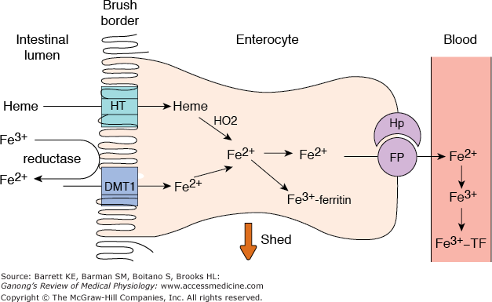
Iron absorption
Fe²⁺ is transported apical membrane iron transporter DMT1.
Heme is transported into the enterocyte by a separate heme transporter HT.

Slide 12
Iron transport and storage

Slide 13
Iron transport and storage
Fe²⁺ upon entering enterocyte, some of it is stored as ferritin
  Remainder is transported out of the enterocytes by a basolateral transporter ferroportin 1
  Hephaestin, a protein associated with ferroportin facilitates basolateral transport
  In the plasma, Fe²⁺ is converted to Fe³⁺ and bound to the iron transport protein transferrin.
Notes:
HP is not a transporter itself, but it facilitates basolateral transport. I

Slide 14
Factors affecting Iron absorption
Dietary factors
Enhances: Vitamin C, cysteine, meat, fish [heme found in meat is readily absorbed than inorganic iron]
Inhibitors: Phosphates in milk, Phytic acid and oxalates in cereal and legumes, Tannates in tea
2. Physiological factors
  State of Iron stores
  Degree of erythropoiesis (Anaemia, Lactation, Pregnancy, Growth)
  Ineffective erythropoiesis.

Slide 15
Iron Excretion
Iron homeostasis is maintained by absorption only, not by excretion
Average daily loss - Male -1 mg/day
- Female – 1.0 to 1.5 mg/day
Routs of loss
- desquamaion
- urine, faeces, bile and sweat
- menstrual cycle
- during pregnancy

Slide 16
Iron deficiency
Iron deficiency is associated with hypochromic, microcytic anaemia.
Reduced stainable bone marrow iron
Low plasma ferritin concentration
Causes : - Dietary lack
- Inadequate intake
- Impaired absorption
- Increased requirement
- Excessive loss
Notes:
Symptoms eg. fatigue, dizziness, headache

Slide 17
Iron overload
Causes:
  Idiopathic haemochromatosis
  Excessive haemolysis
  Increased Dietary intake
  Inappropriate oral therapy
  Parental administration [Inappropriate parental iron therapy]
  Multiple blood transfusion
  Excess iron deposit in tissues as Ferritin and hemosiderin
  Liver: cirrhosis , Pancreas: Diabetes, Skin: bronze pigmentation
Treatment : Iron chelators - desferrioxamine and deferasirox

Slide 18
Markers for Body iron status
Biochemical Parameters
Serum Iron level ( Transferrin bound iron)
Total Iron Binding capacity (TIBC)
% transferrin saturation = (Serum iron/TIBC x 100)
Serum ferritin : Level correlates with body stores
Soluble transferrin receptor levels
  Hematological parameters
  Red cell indices – MCV, MCH
  Microcytic/Hypochromic/Normocytes

Slide 19
Markers for Body iron status cont…
Plasma Iron transport
1. Transferrin
Glyco protein produced by liver
Apotransferrin + Fe³⁺ holo Transferrin
(300 μg/dl) (90 μg/dl)

Slide 20
Markers for Body iron status cont…
Total Iron binding Capacity (TIBC)
Saturated Iron Binding Capacity (SIBC/SI/ BI)
Unsaturated Iron Binding Capacity (UIBC)
+
Apotransferrin bound to Iron (Transferrin)
Iron free Apotransferrin
All Apotransferrin

Slide 21
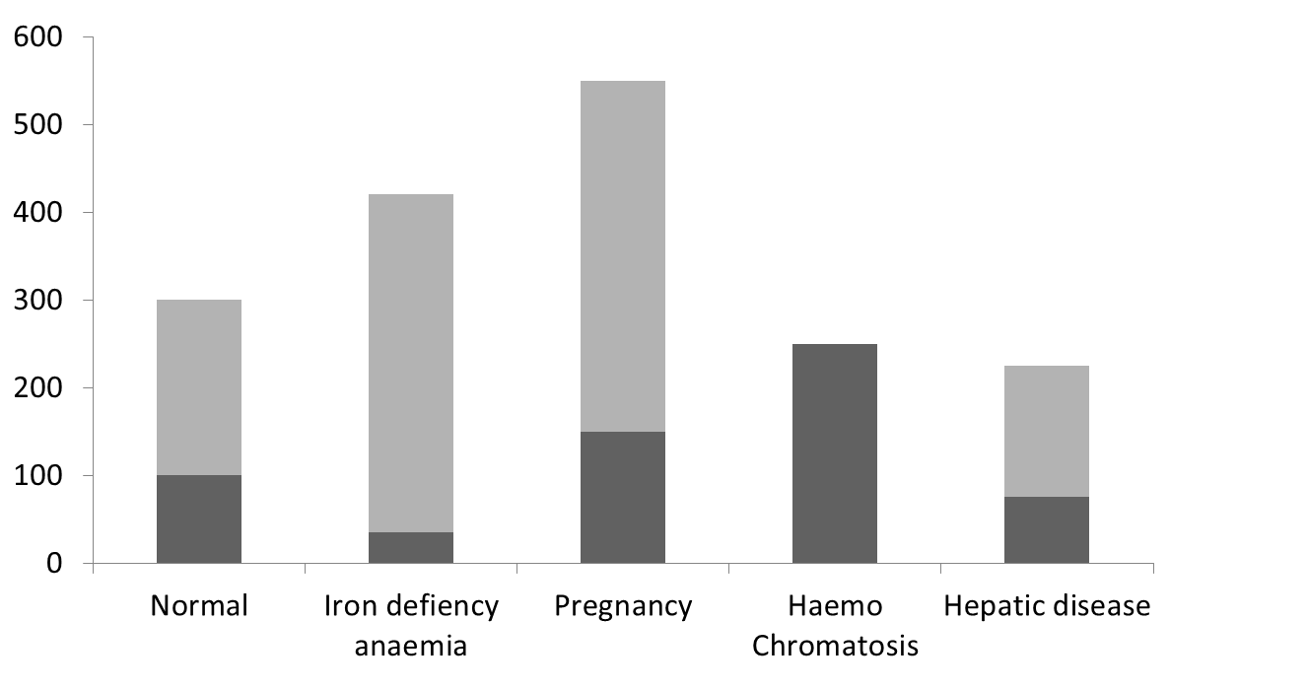
Changes in body iron status
Fe μg/dl
TIBC
SIBC

Slide 22
2. Ferritin
Cells store excess iron in cytoplasm as ferritin
Core protein
Has 24 H and L chains
Can store 4500 Fe³⁺ ions

Slide 23
Iron status assessment
Bound iron/Serum Iron /SIBC – Normal 115 μg/dl
        – Iron def. < 40 μg/dl – Iron overload >175 μg/dl
TIBC – Normal - 330 μg/dl
– Iron def. - 410 μg/dl
– Iron overload < 300 μg/dl
% saturation of transferrin = [SIBC/TIBC]*100
35 %Normal
< 15 % Iron def.
> 60 % Iron overload
Plasma ferritin: Accurate measurement difficult to perform.
< 12 μg/dl complete absence of stored iron
100 μg/dl - normal
> 300 μg/dl - Iron overload

Slide 24
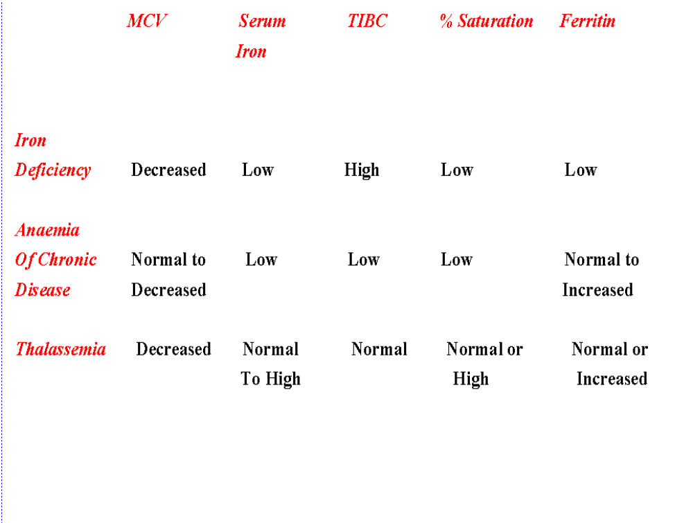
DIFFERENTIAL DIAGNOSIS: IRON DEFICIENCY ANAEMIA

